Slide 1
Building a Machine Learning Pipeline to Flag Students at Risk of Failing
Eli Ordonez - DAB Technical Interview Case Challenge

Slide 2
Problem Statement
The Ministry of Education is developing a resource that can help Math Head-of-Departments (HODs) identify students at risk of failing their Math O-Levels based on their environmental factors.
Based on data on last year’s O-Level Math exam participants, I need to design an end-to-end machine learning pipeline that can accurately predict whether a student will fail their exam.

Slide 3
Limitations
Assumptions:
Each row in the dataset represents Secondary 4 students
The students’ background information was representative of their lifestyle/environmental factors until the O-Level exam
Analysis was limited to the data presented to me
Potentially influential factors (e.g. household income, neighbourhood, etc) could not be investigated
I used logistic regression to predict ‘y’ so HODs can interpret the results easily
Downside: Non-linear relationships not accounted for

Slide 4
Important Notes on Data Cleaning
900 rows of duplicates were dropped
Rows where ‘attendance_rate’ or ‘final_test’ were null were dropped, amounting to 7.98% of the data.
Both being continuous variables, it would be difficult to accurately impute the missing values.
Only < 10% of actual data lost
Missing values under ‘CCA’ were imputed using predictive modelling (random forest)
24% of ‘CCA’ was null, but its potential importance prevented me from dropping it
‘Final_test’ is NOT my y-variable, but an engineered binary feature called ‘failed’

Slide 5
Features Used
Feature | Data Dictionary Description
Gender | Gender type
Learning_style | Primary learning style
Attendance_rate | Attendance rate of the student (%)
N_male | Number of male classmates
N_female | Number of female classmates
Direct_admission | Mode of entering the school
CCA | Enrolled CCA
Tuition | Indication of whether the student has a tuition
Hours_per_week | Number of hours student studies per week
Number_of_siblings | Number of siblings
Sleep_dur (Engineered from ‘sleep_time’ and ‘wake_time’) | Duration of sleep every night
Failed (Engineered from ‘final_test’) | Indication of whether a student has failed their Math O-Level examinations

Slide 6
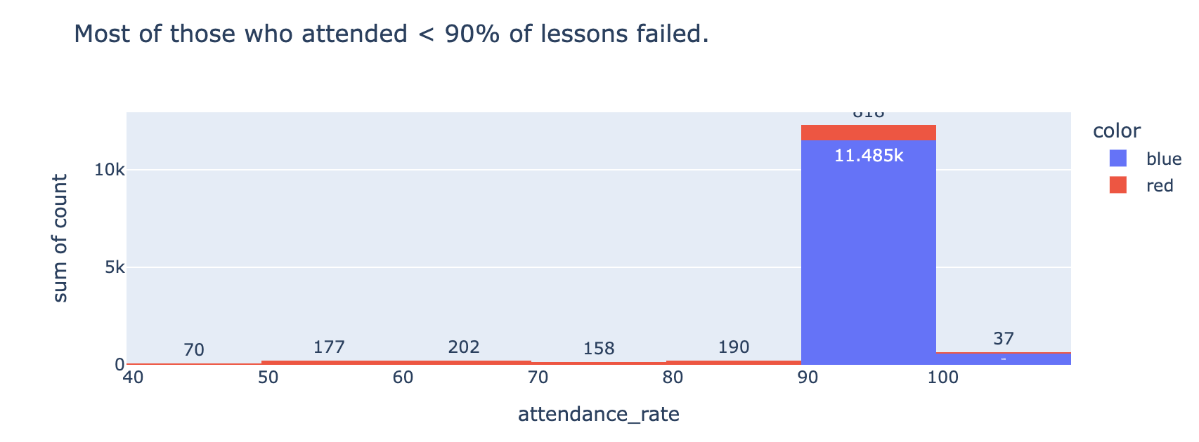
Important EDA Findings: ‘attendance_rate’
The relationship between ‘attendance_rate’ and ‘failed’ was the strongest negative one among all features

Slide 7
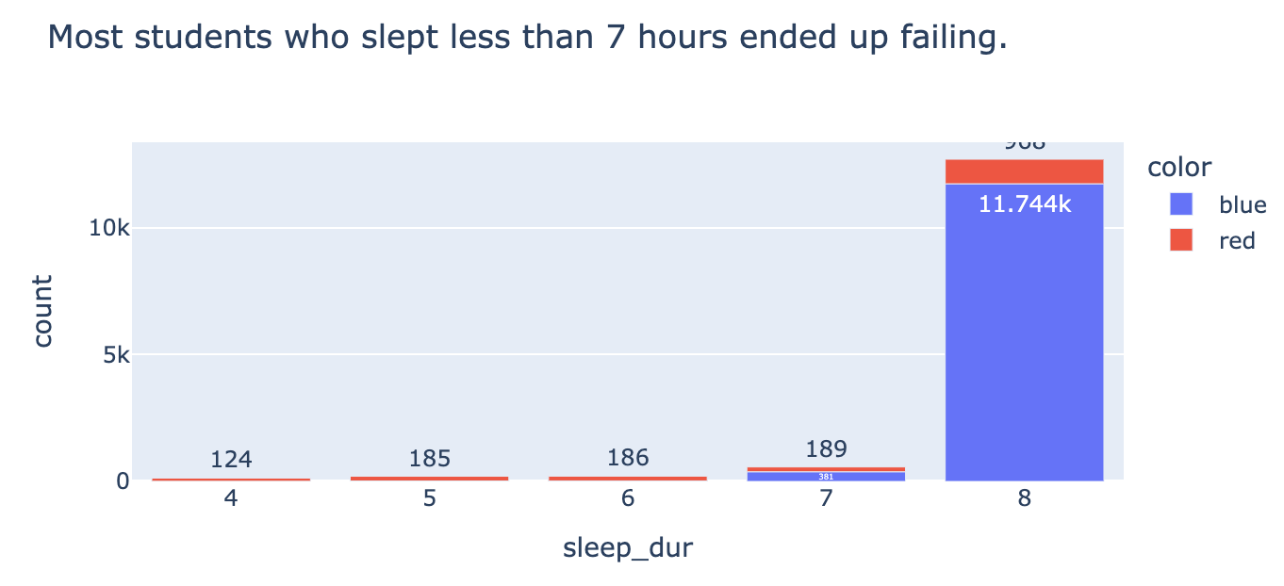
Important EDA Findings:
‘sleep_dur’
The relationship between ‘sleep_dur’ and ‘failed’ was the second-strongest negative relationship among all features.

Slide 8
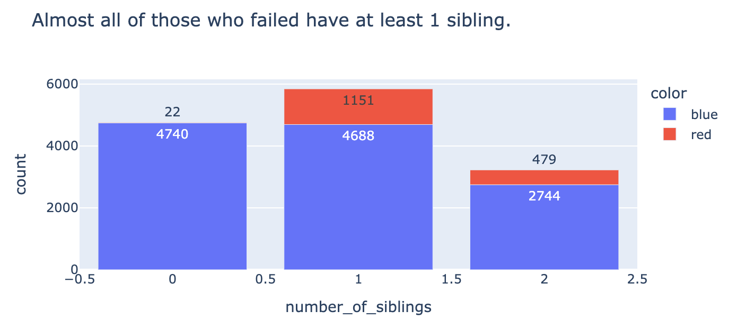
Important EDA Findings: ‘number_of_siblings’
The relationship between ‘number_of_siblings’ and ‘failed’ was the highest positive relationship among all features

Slide 9
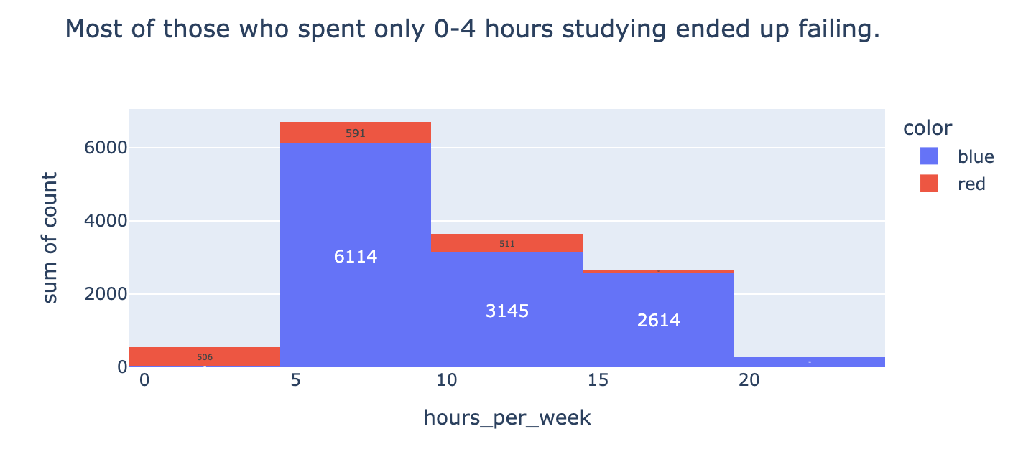
Important EDA Findings: ‘hours_per_week’
The relationship between ‘hours_per_week’ and ‘failed’ was also quite strongly negative

Slide 10
Pipeline Output
The pipeline I designed produces two outputs:
A dataset (‘predict_df.csv’) which includes
Predicted y values
X_test features (So the HOD has more context to the predictions while analysing the data)
Metrics on the Model’s Performance:
Accuracy (How accurate the model's predictions is overall) = 94.3%
Precision (Of predicted failures, which were actually failures?) = ~86%
Recall (Of actual failures, which were predicted correctly?) = ~63%

Slide 11
What Can the Data Tell Us?
Overall, schools can emphasise better daily time management to ensure students get
Adequate daily rest (at least 7 hours)
Enough time for at least 5 hours to study math per week
But more data will always help…
More data can be collected on why siblings can affect a student’s exam performance
More data can be gathered for a more comprehensive understanding of students’ struggles in math (e.g. household income, how much extracurricular lessons they are receiving, etc)

Slide 12
Thank you!
Q&A

